Slide 1
MA/CSSE 473 Day 33
Data Compression
Minimal Spanning Tree Intro

Slide 2
Data Compression
More important than ever …
This presentation repeats my CSSE 230 presentation

Slide 3

Data (Text) Compression
YOU SAY GOODBYE. I SAY HELLO. HELLO, HELLO. I DON'T KNOW WHY YOU SAY GOODBYE, I SAY HELLO.
Letter frequencies
There are 90 characters altogether.
How many total bits in the ASCII representation of this string?
We can get by with fewer bits per character (custom code)
How many bits per character? How many for entire message?
Do we need to include anything else in the message?
How to represent the table?
1. count 2. ASCII code for each character How to do better?
Q1-2

Slide 4
Compression algorithm: Huffman encoding
Named for David Huffman
http://en.wikipedia.org/wiki/David_A._Huffman
Invented while he was a graduate student at MIT.
Huffman never tried to patent an invention from his work. Instead, he concentrated his efforts on education.
In Huffman's own words, "My products are my students."
Principles of variable-length character codes:
Less-frequent characters have longer codes
No code can be a prefix of another code
We build a tree (based on character frequencies) that can be used to encode and decode messages
Q3-4

Slide 5
Variable-length Codes for Characters
Assume that we have some routines for packing sequences of bits into bytes and writing them to a file, and for unpacking bytes into bits when reading the file
Weiss has a very clever approach:
BitOutputStream and BitInputStream
methods writeBit and readBit allow us to logically read or write a bit at a time

Slide 6
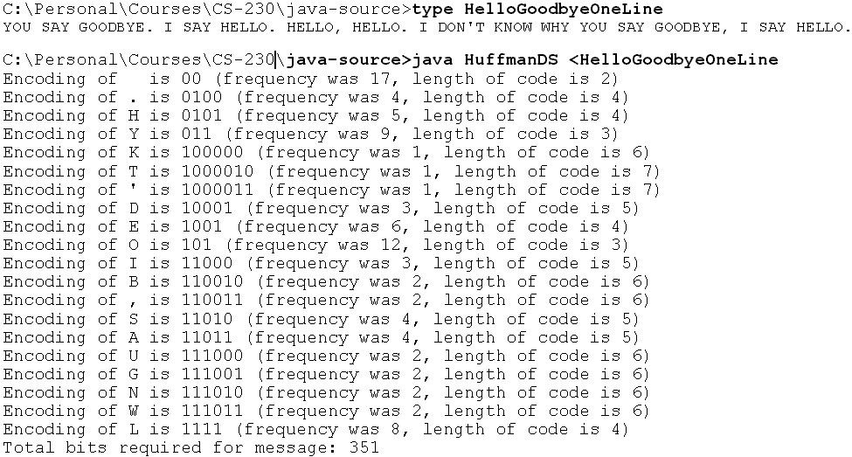
A Huffman code: HelloGoodbye message
Decode a "message"
Draw part of the Tree

Slide 7
Build the tree for a smaller message
I 1
R 1
N 2
O 3
A 3
T 5
E 8
Start with a separate tree for each character (in a priority queue)
Repeatedly merge the two lowest (total) frequency trees and insert new tree back into priority queue
Use the Huffman tree to encode NATION.
Huffman codes are provably optimal among all single-character codes
Q5-8
Notes:
Note that we would not normally encode any messages other than the one that generates the frequency counts. This example is for illustration only.

Slide 8
What About the Code Table?
When we send a message, the code table can basically be just the list of characters and frequencies
Why?
Three or four bytes per character
The character itself.
The frequency count.
End of table signaled by 0 for char and count.
Tree can be reconstructed from this table.
The rest of the file is the compressed message.
Q9
Notes:
Because we can send this along, and the tree can be reconstructed at the other end. Probably faster than sending an elaborate table.

Slide 9
Huffman Java Code Overview
This code provides human-readable output to help us understand the Huffman algorithm.
We will deal with it at the abstract level; "real" code to do file compression is found in DS chapter 12.
I am confident that you can figure out the other details if you need them.
This code is based on code written by Duane Bailey, in his book JavaStructures.
A great thing about this example is the use of various data structures (Binary Tree, Hash Table, Priority Queue).
473: I do not want to get caught up in lots of code details in class, so I ask you to read this on your own.

Slide 10
Some Classes used by Huffman
Leaf: Represents a leaf node in a Huffman tree.
Contains the character and a count of how many times it occurs in the text.
HuffmanTree: Each node contains the total weight of all characters in the tree, and either a leaf node or a binary node with two subtrees that are Huffman trees.
The contents field of a non-leaf node is never used; we only need the total weight.
compareTo returns its result based on comparing the total weights of the trees.

Slide 11
Classes used by Huffman, part 2
Huffman: Contains main The algorithm:
Count character frequencies and build a list of Leaf nodes containing the characters and their frequencies
Use these nodes to build a sorted list (treated like a priority queue) of single-character Huffman trees
do
Take two smallest (in terms of total weight) trees from the sorted list
Combine these nodes into a new tree whose total weight is the sum of the weights of the new tree
Put this new tree into the sorted list
while there is more than one tree left The one remaining tree will be an optimal tree for the entire message

Slide 12
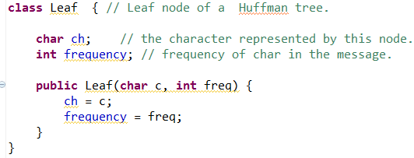
Leaf node class for Huffman Tree
The code on this slide (and the next four slides) produces the output shown on the A Huffman code: HelloGoodbye message slide.

Slide 13
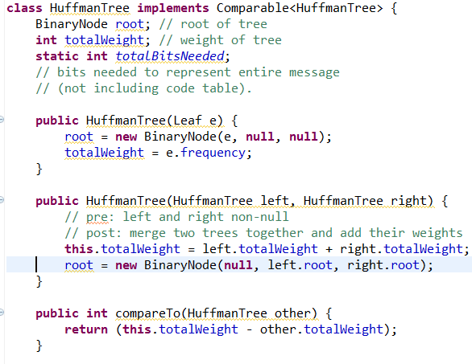
Highlights of the HuffmanTree class

Slide 14
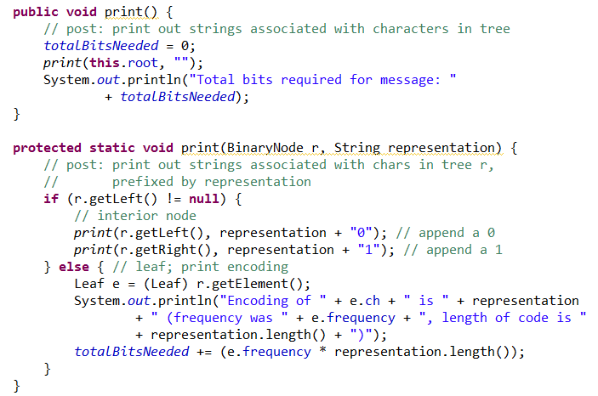
Printing a HuffmanTree

Slide 15
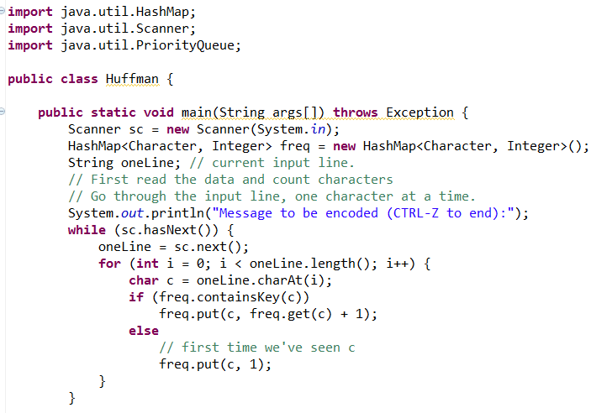
Highlights of Huffman class part 1

Slide 16
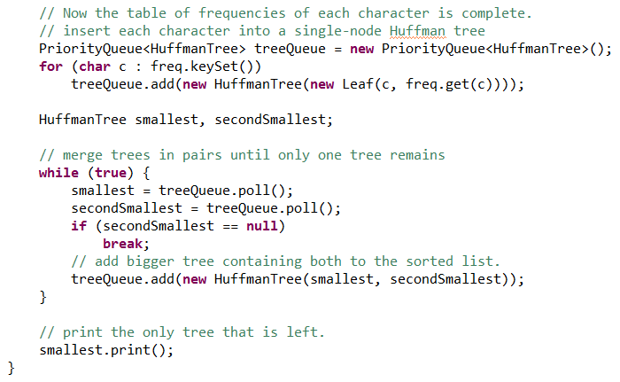
Remainder of the main() method

Slide 17
Summary
The Huffman code is provably optimal among all single-character codes for a given message.
Going farther:
Look for frequently occurring sequences of characters and make codes for them as well.

Slide 18
Algorithms for finding a Minimal Spanning tree
Kruskal and Prim
Q10-11

Slide 19
Kruskal’s algorithm
To find a MST (minimal Spanning Tree):
Start with a graph T containing all of G’s n vertices and none of its edges.
for i = 1 to n – 1:
Among all of G’s edges that can be added without creating a cycle, add to T an edge that has minimal weight.
Details of Data Structures next time
Q12

Slide 20
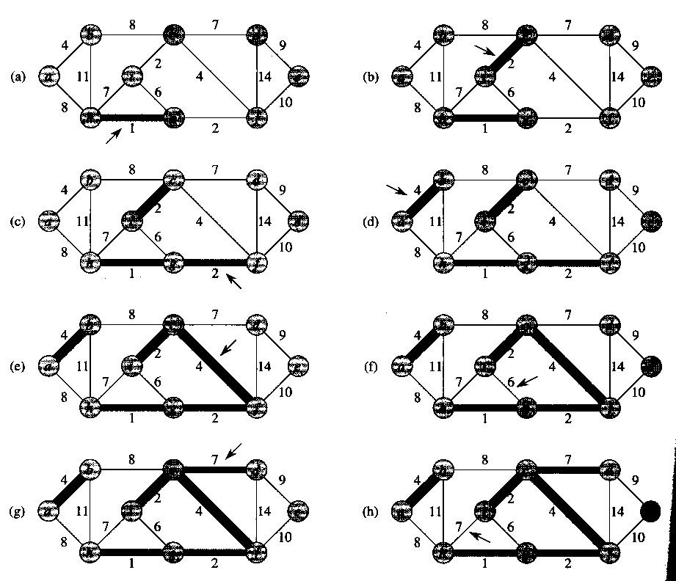

Slide 21
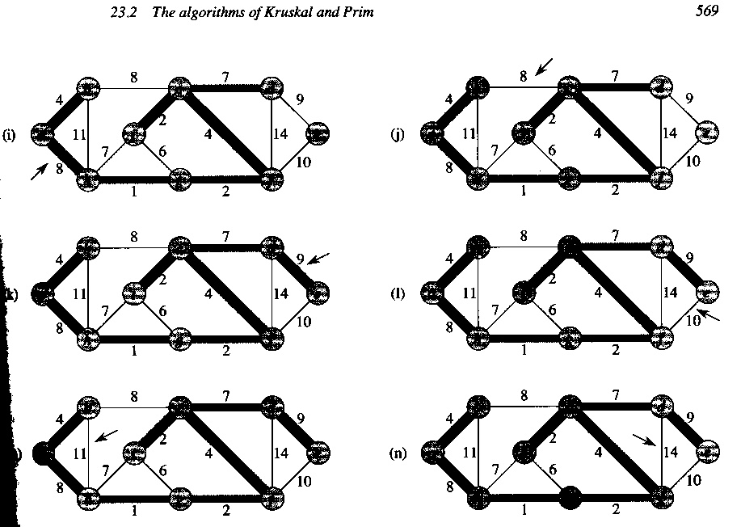

Slide 23
Prim’s algorithm
Start with T as a single vertex of G (which is a MST for a single-node graph).
for i = 1 to n – 1:
Among all edges of G that connect a vertex in T to a vertex that is not yet in T, add a minimum-weight edge (and the vertex at the other end of T).
Details of Data Structures next time
Q13-15

Slide 24
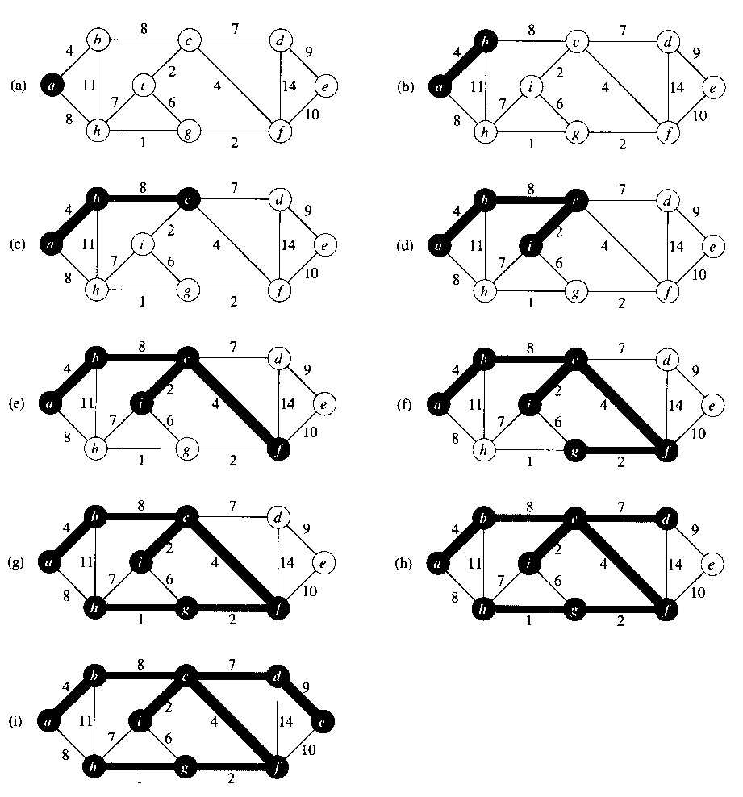
Example of Prim’s algorithm

Slide 25
Correct?
These algorithms seem simple enough, but do they really produce a MST?
Next time begin with a lemma that is the crux of both proofs.

